Slide 1
Object Oriented Programming using Java (ECSE102L)

Slide 2
Outline
Array
Why to use Array?
Declaring an Array
Types of Array
Single Dimensional Array
Multi Dimensional Array

Slide 3
Array
S
Array is a collection of elements of similar data types.
The size (length) of an array is fixed. It cannot be changed after defining.
The size of an array must be specified by an int value.
The first element of an array starts with index zero.
An element of an array is accessed by its respective index.
Java array can be also used as a static field, a local variable or a method parameter.

Slide 4
Array (Cont…)
S
index[0] index[1] index[2] index[3] index[4] index [5]
Array length: 6
First index: 0
Last index: 5
104 | 532 | 703 | 451 | 673 | 983

Slide 5
Why to use Array?
S
Code Optimization: It makes the code optimized, we can retrieve or sort the data efficiently.
Random access: We can get any data located at an index position.

Slide 6
Declaring an Array
S
Declaring
int []hello;
int hello[];
int hello[]={1 , 2, 3, 4, 5, 6};
Class_name[] Array_name;
Class_name Array_name[];
Instantiating/constructing
var-name = new type [size]; //syntax
hello = new int[10];

Slide 7
Declaring an Array (Cont…)
S
Initialize an Array
hello[0]=10;
hello[1]=11;
Array Literal
int[] hello = new int[]{1, 3, 5, 7, 9};
int[] hello = {1, 3, 5, 7, 9}; //new is not required in new version of Java

Slide 8
Types of Array
S
Single dimensional array
Multi dimensional array

Slide 9
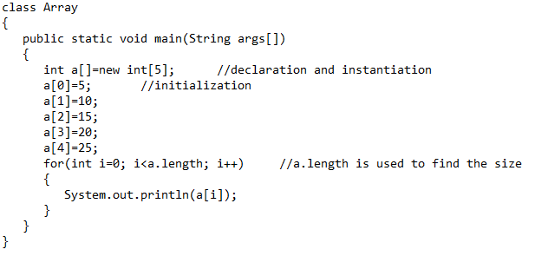
Single Dimensional Array
S

Slide 10
Single Dimensional Array (Cont…)
S
Output
  5
  10
  15
  20
  25

Slide 11
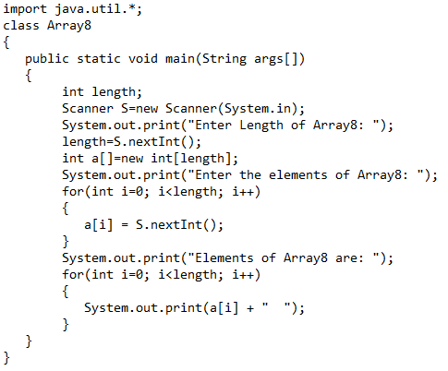
Single Dimensional Array
S

Slide 12
Single Dimensional Array (Cont…)
S
Output
  Enter Length of Array8:
  Enter the elements of Array8:
  Elements of Array8 are:

Slide 13
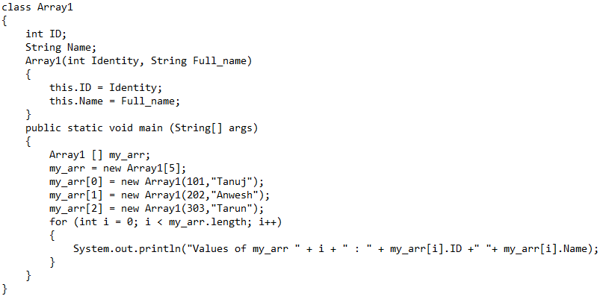
Single Dimensional Array (Cont…)
S
Creating an array of objects

Slide 14
Single Dimensional Array (Cont…)
S
Output
  Values of my_arr 0 : 101 Tanuj
  Values of my_arr 1 : 202 Anwesh
  Values of my_arr 2 : 303 Tarun
  Exception

Slide 15
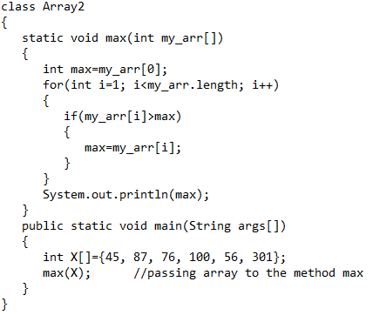
Single Dimensional Array (Cont…)
S
Passing an array to a method

Slide 16
Single Dimensional Array (Cont…)
S
Output
  301

Slide 17
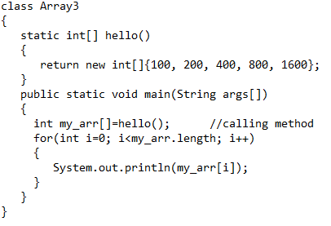
Single Dimensional Array (Cont…)
S
Returning an array from a method

Slide 18
Single Dimensional Array (Cont…)
S
Output
  100
  200
  400
  800
  1600

Slide 19
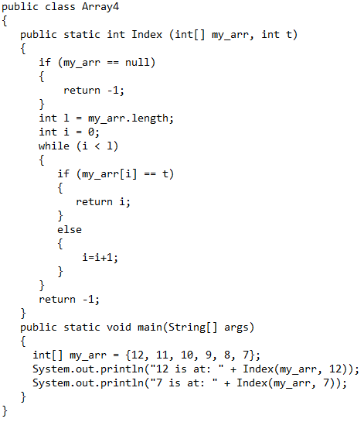
Single Dimensional Array (Cont…)
S
Returning an array from a method (Cont…)

Slide 20
Single Dimensional Array (Cont…)
S
Output
  12 is at: 0
  7 is at: 5

Slide 21
Multi Dimensional Array
S
A multidimensional array is an array that contains one or more arrays.
In multidimensional array, element of the array holds the reference of another array.
A multidimensional array is created by using one set of square brackets “[]” per dimension.
It is mostly used.

Slide 22
Multi Dimensional Array (Cont…)
S
To declare a multidimensional array variable, specify each additional index using another set of square brackets.
int twoDimen[ ][ ] = new int[4][5];
int[][] my_arr = { {1, 2, 3, 4}, {5, 6, 7} };

Slide 23
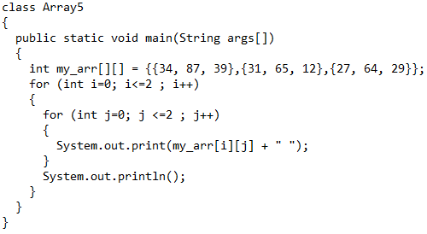
Multi Dimensional Array (Cont…)
S

Slide 24
Multi Dimensional Array (Cont…)
S
Output
  34 87 39
  31 65 12
  27 64 29

Slide 25
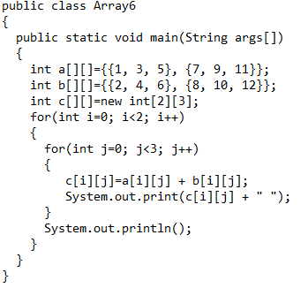
Multi Dimensional Array (Cont…)
S

Slide 26
Multi Dimensional Array (Cont…)
S
Output
  3 7 11
  15 19 23

Slide 27
Multi Dimensional Array (Cont…)
S
Write a Java program to multiply two matrices:
A= 2 4 6
8 10 12
14 16 18
B= 1 3 5
7 9 11
13 15 17

Slide 28
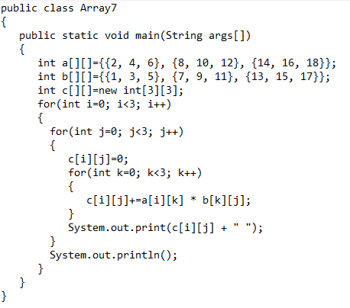
Multi Dimensional Array (Cont…)
S

Slide 29
Multi Dimensional Array (Cont…)
S
Output
  108 132 156
  234 294 354
  360 456 552

Slide 30




